Slide 1

Chapter 13

Slide 2
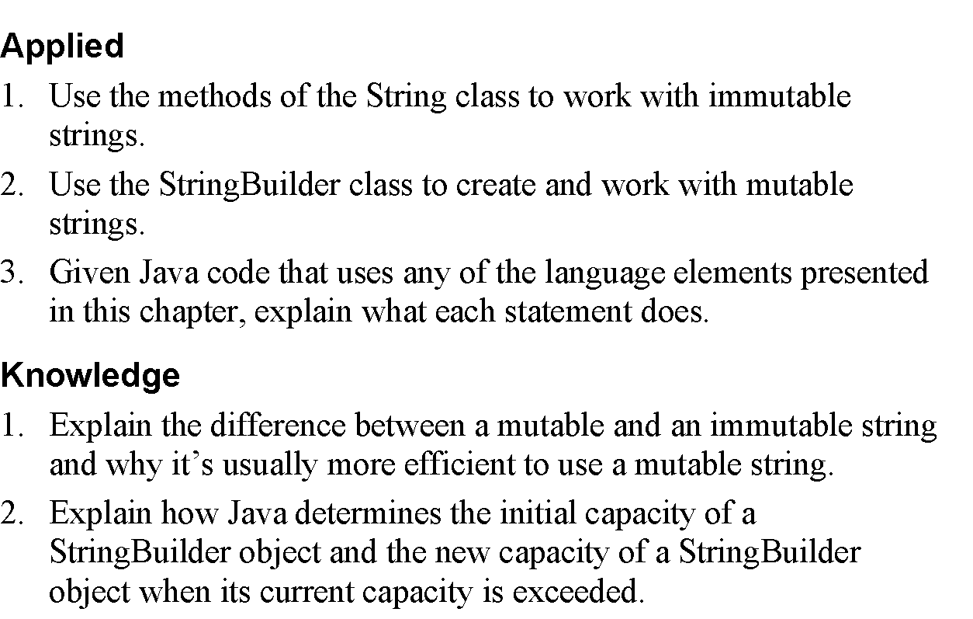
Objectives

Slide 3
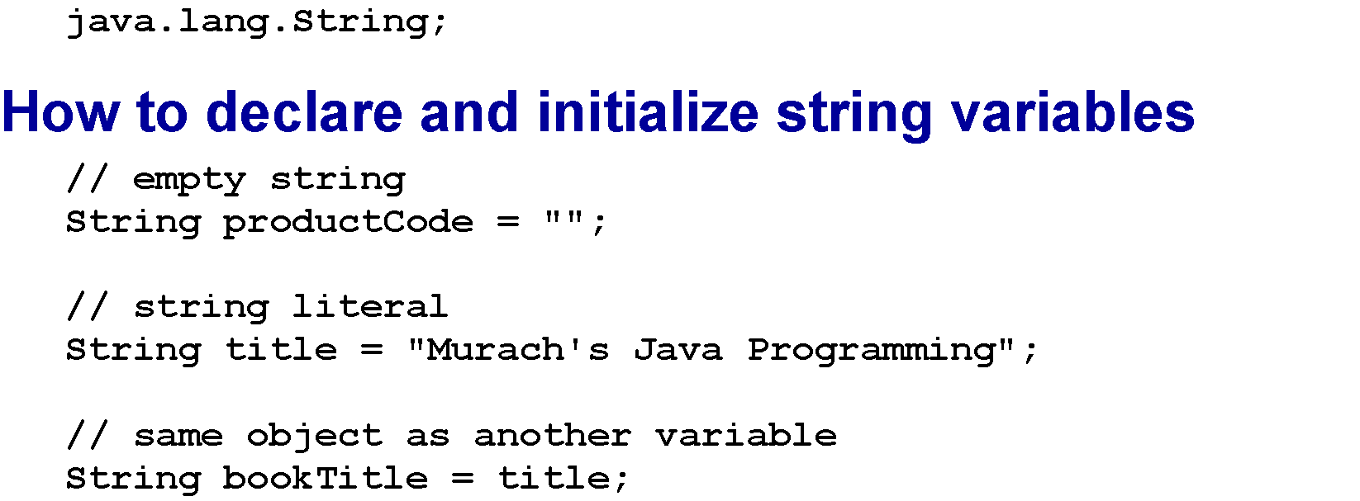
The String class

Slide 4
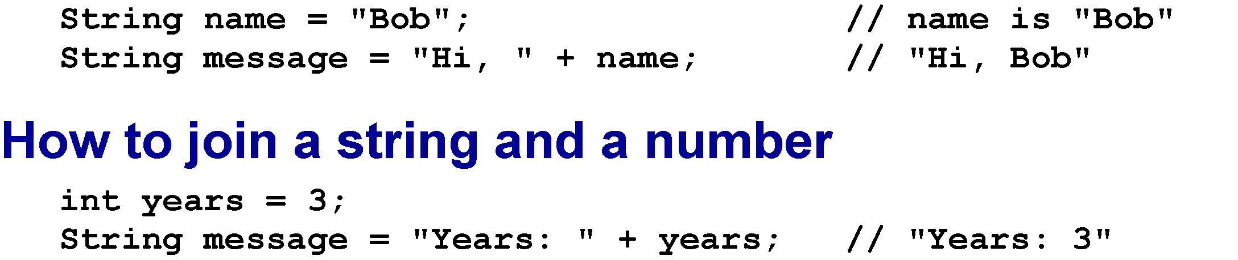
How to join strings

Slide 5
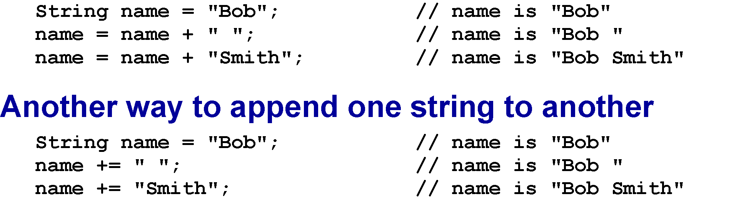
How to append one string to another

Slide 6
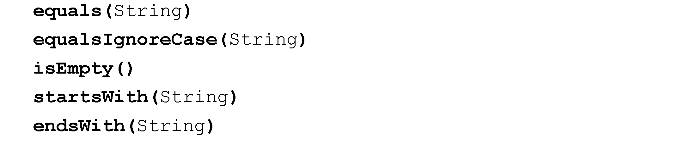
Methods for comparing strings

Slide 7
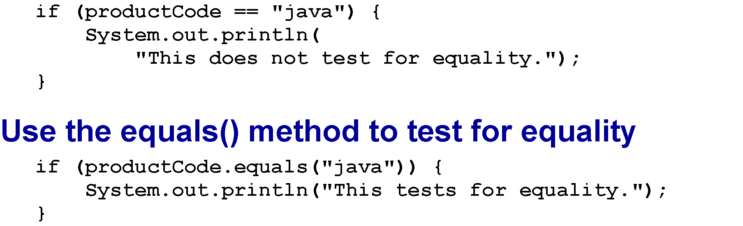
A common mistake when testing for equality

Slide 8
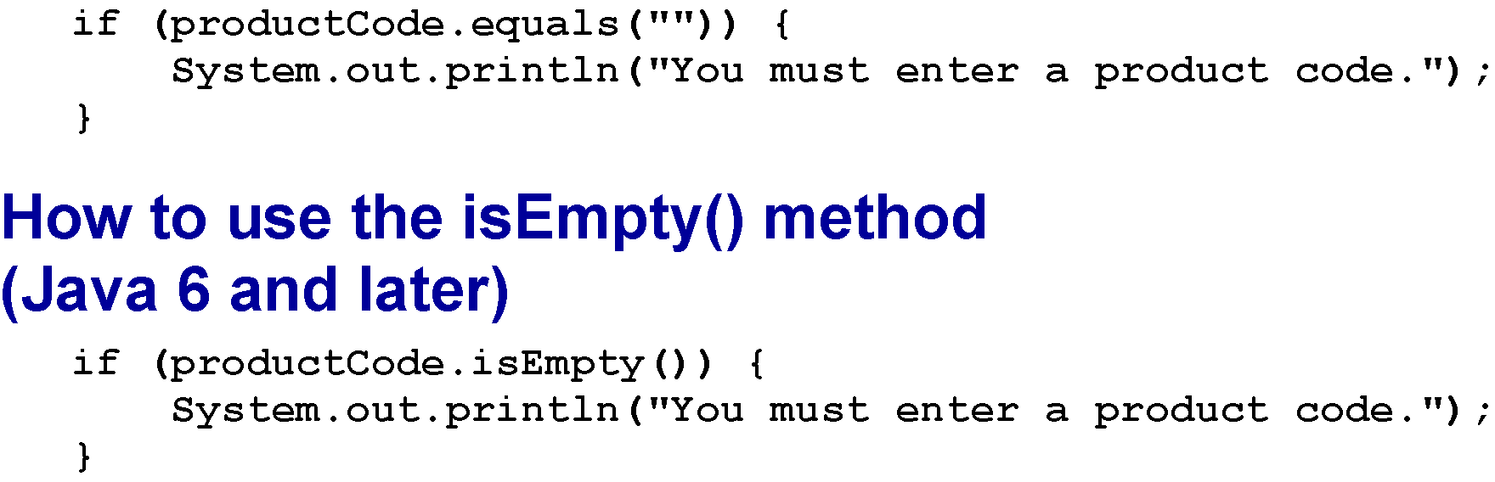
How to use the equals() method to check for an empty string

Slide 9
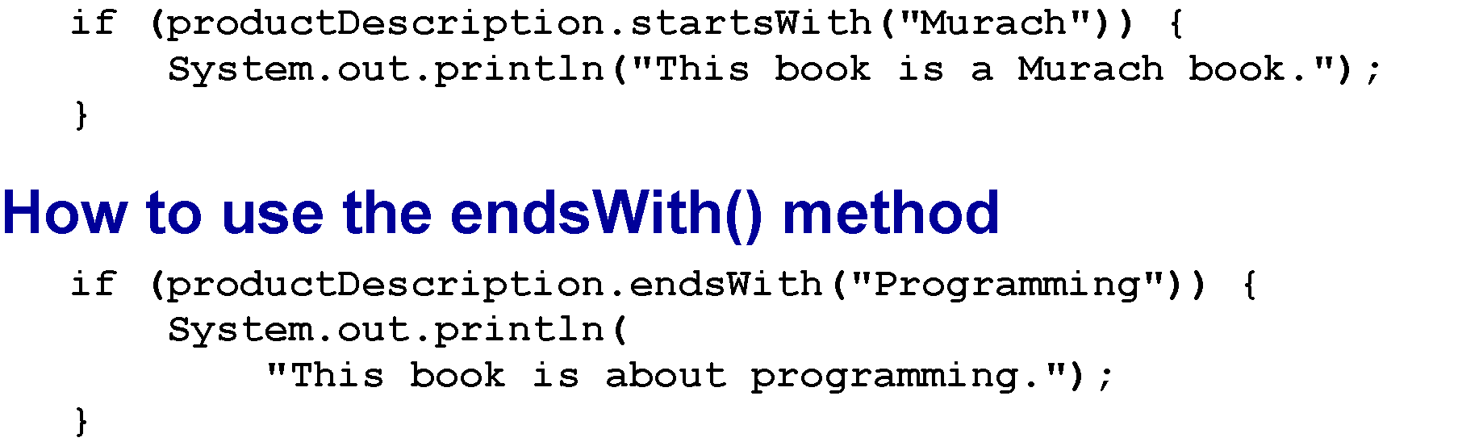
How to use the startsWith() method

Slide 10
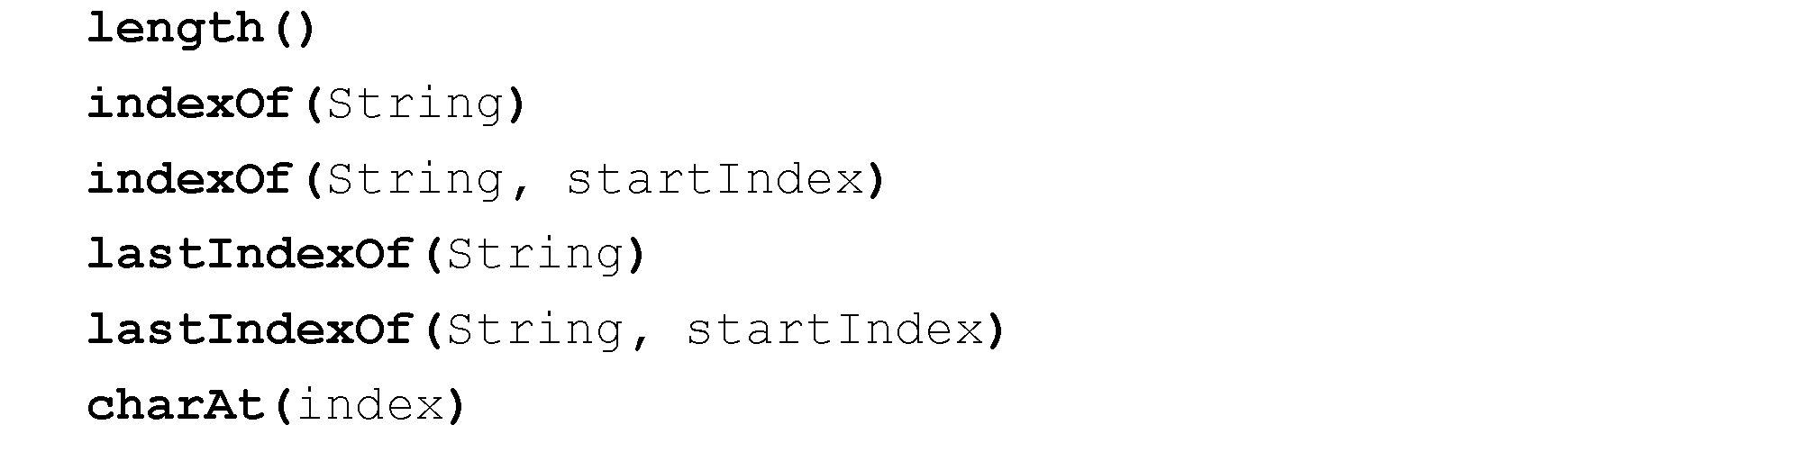
Methods for working with string indexes

Slide 11
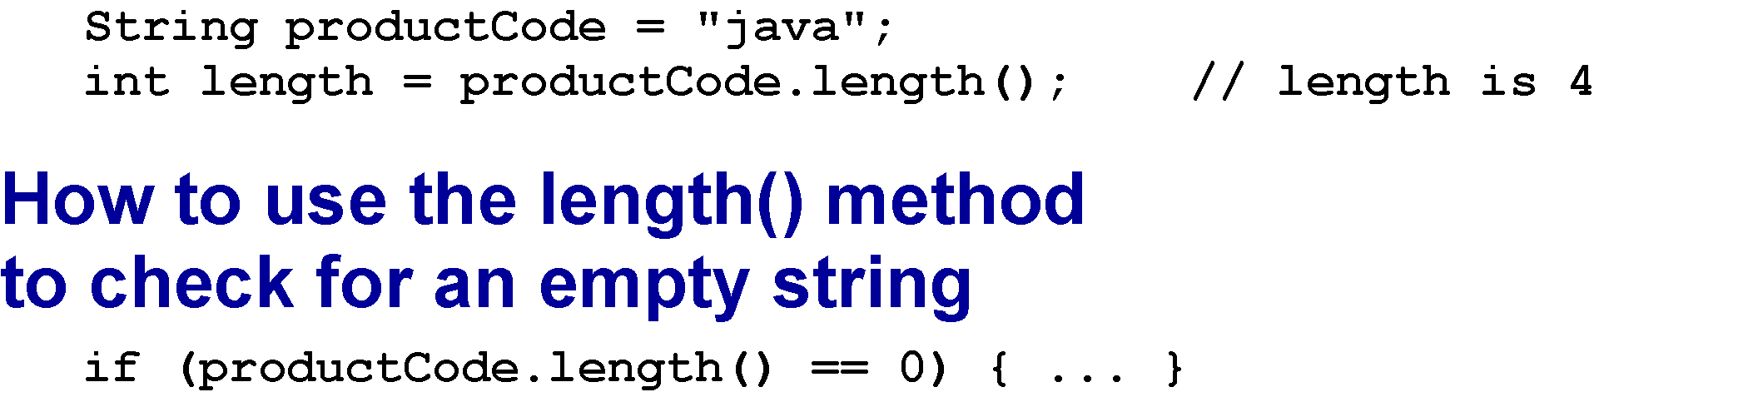
How to get the length of a string

Slide 12
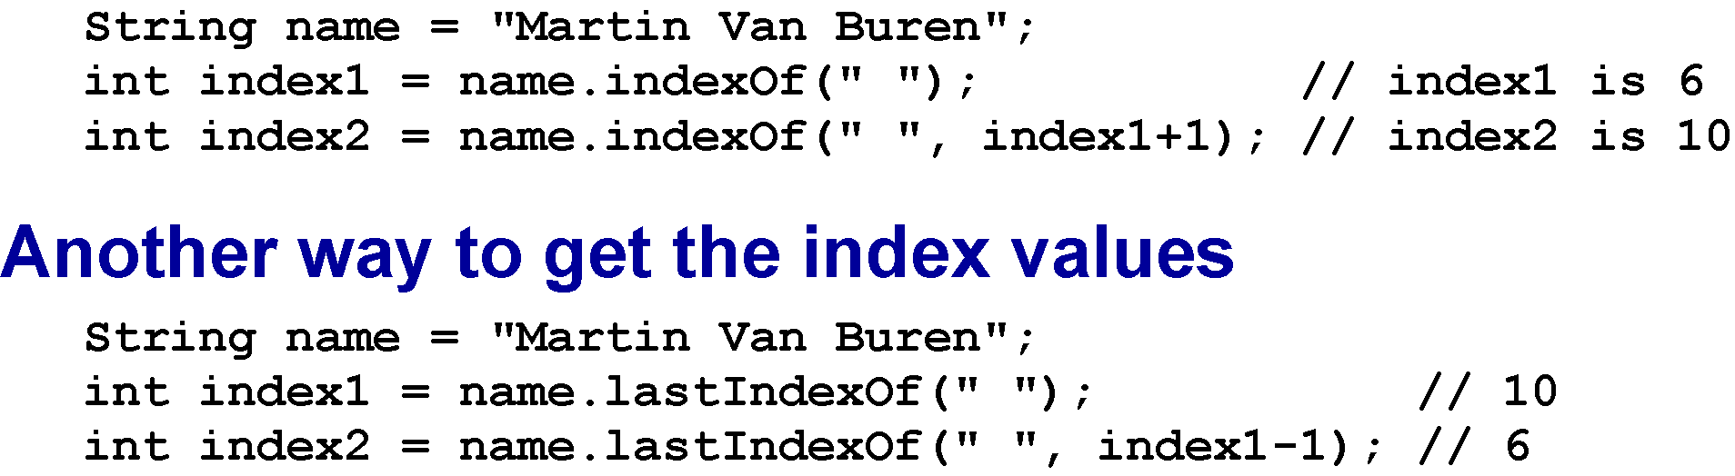
Get the index values for the two spaces

Slide 13
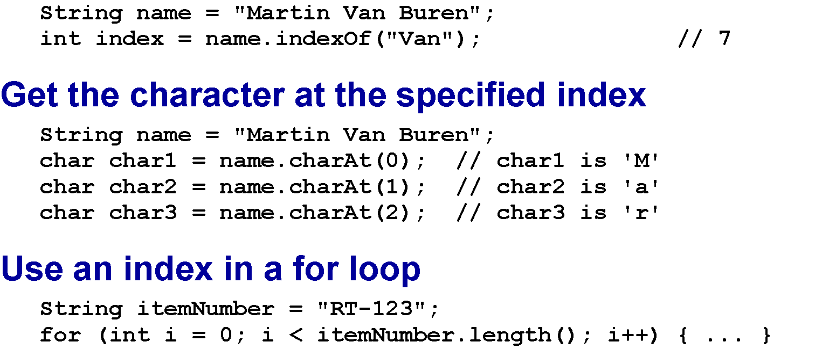
Get the index of a string

Slide 14
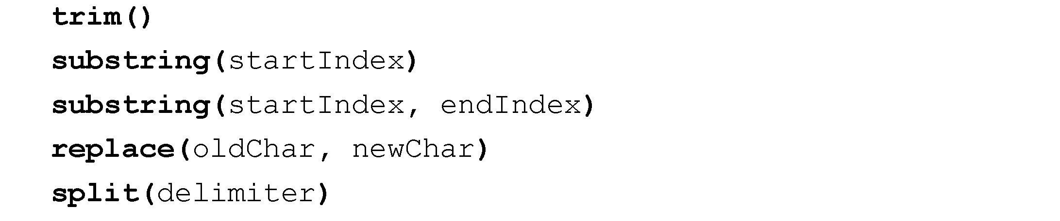
Methods for modifying strings

Slide 15
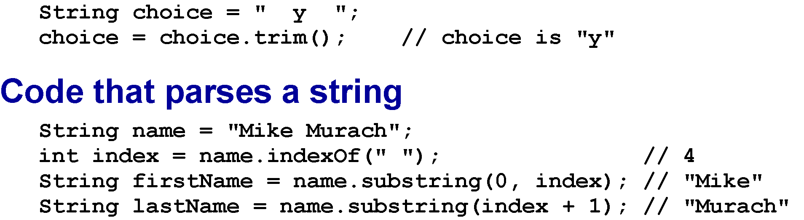
Code that trims spaces from a string

Slide 16
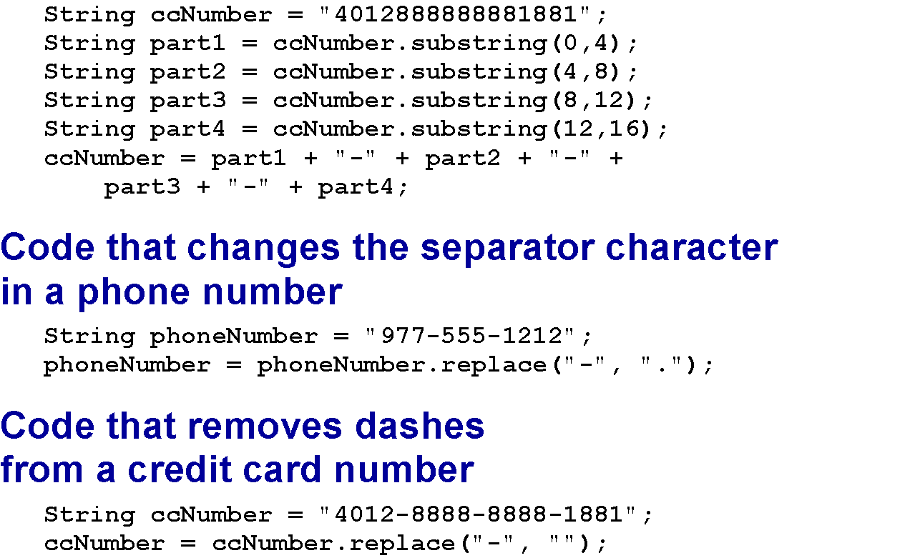
Code that adds dashes to a credit card number

Slide 17
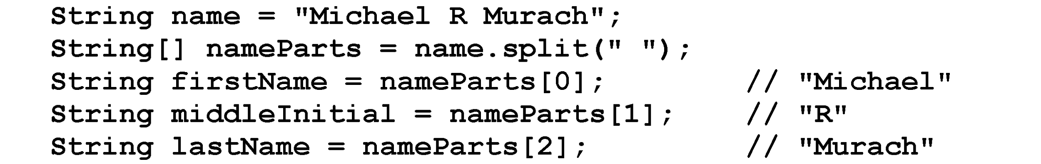
Code that stores the parts of a name in an array

Slide 18
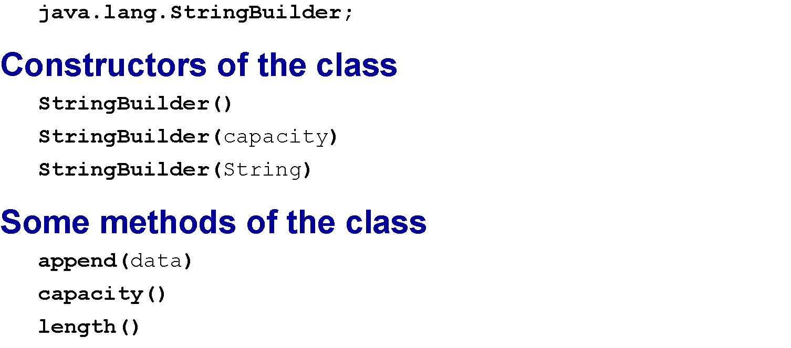
The StringBuilder class

Slide 19
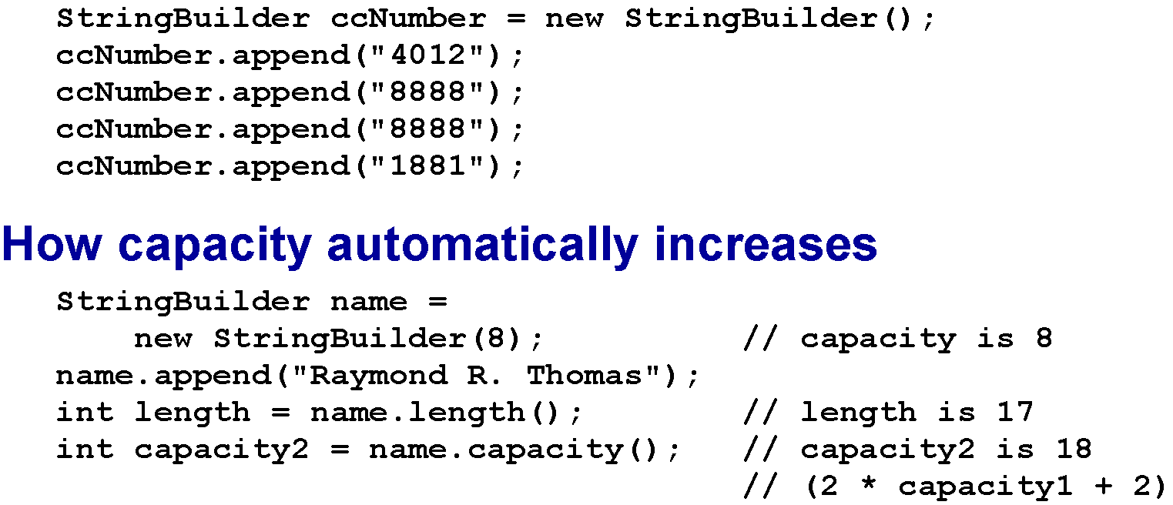
Code that creates a credit card number

Slide 20
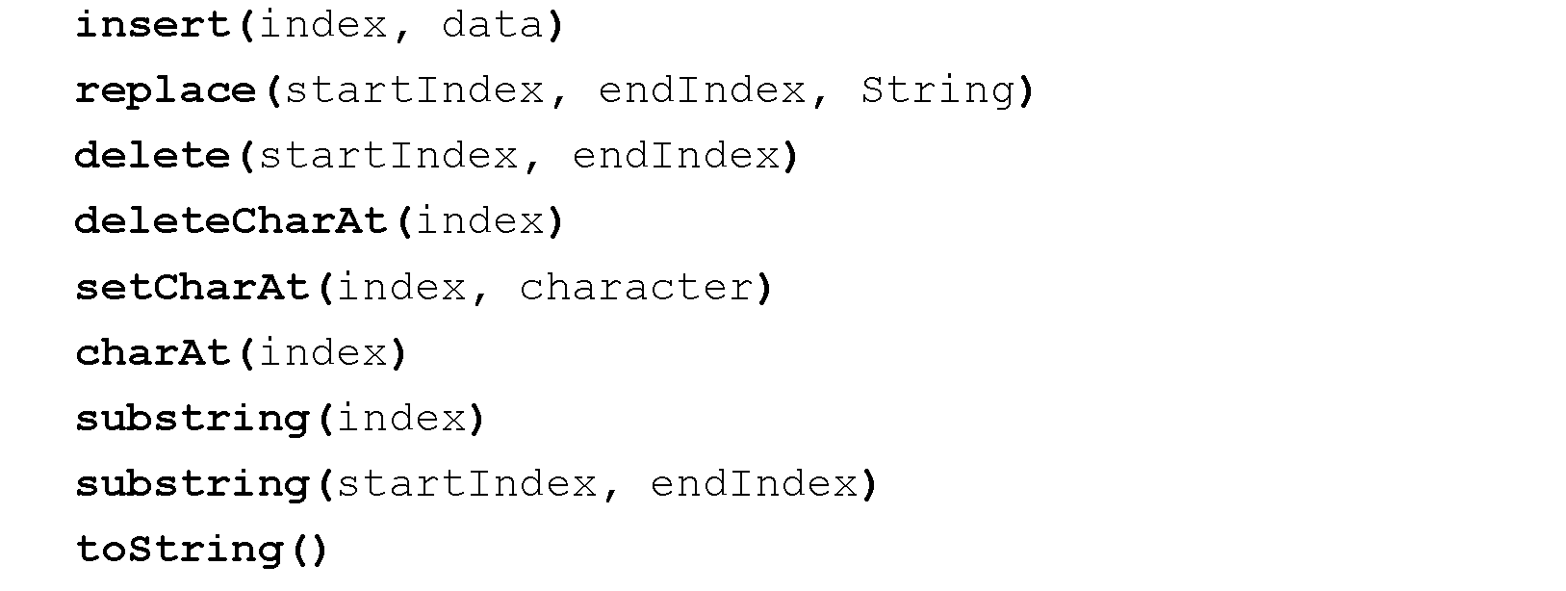
More methods of the StringBuilder class

Slide 21
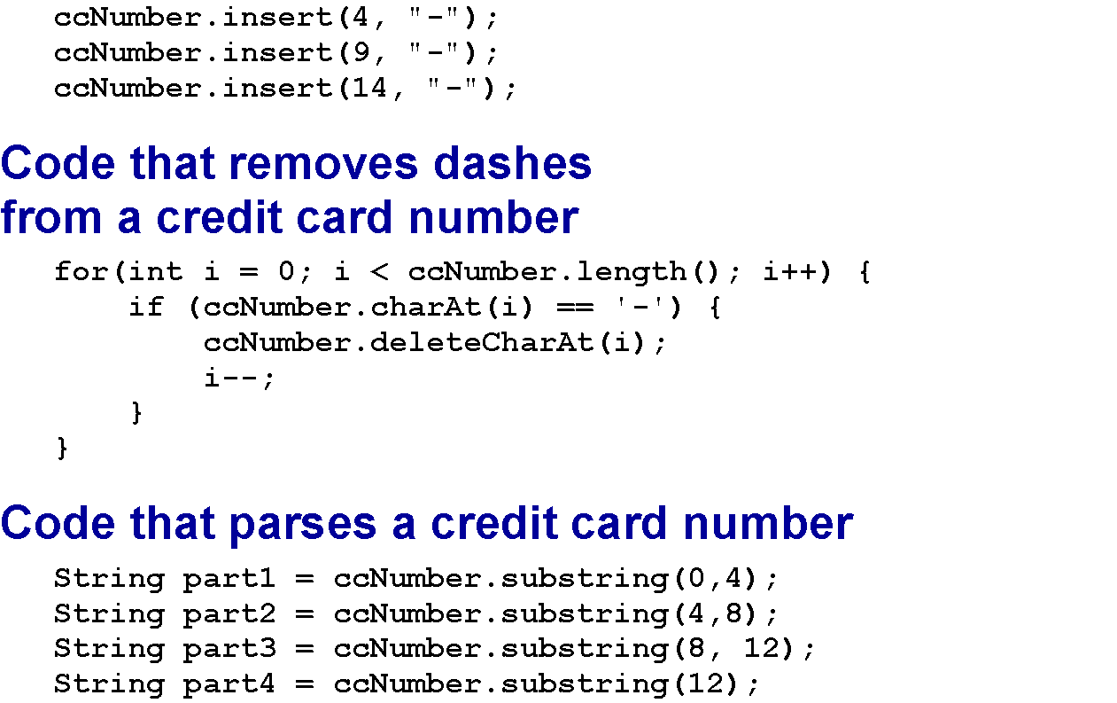
Code that adds dashes to a credit card number

Slide 22
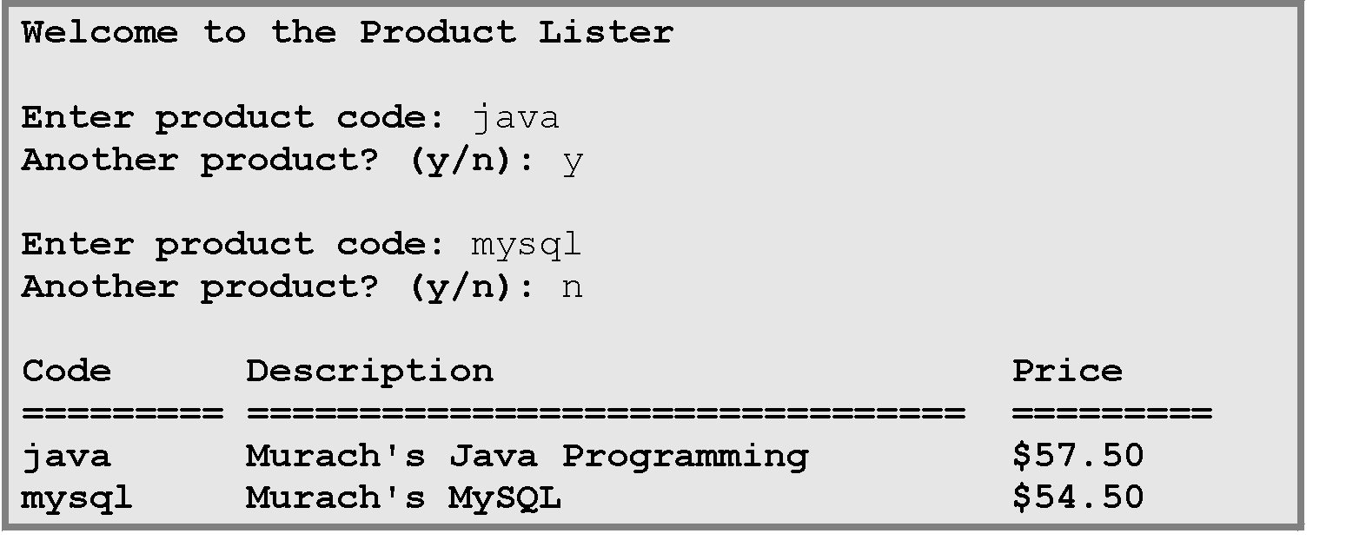
The console for the Product Lister application

Slide 23
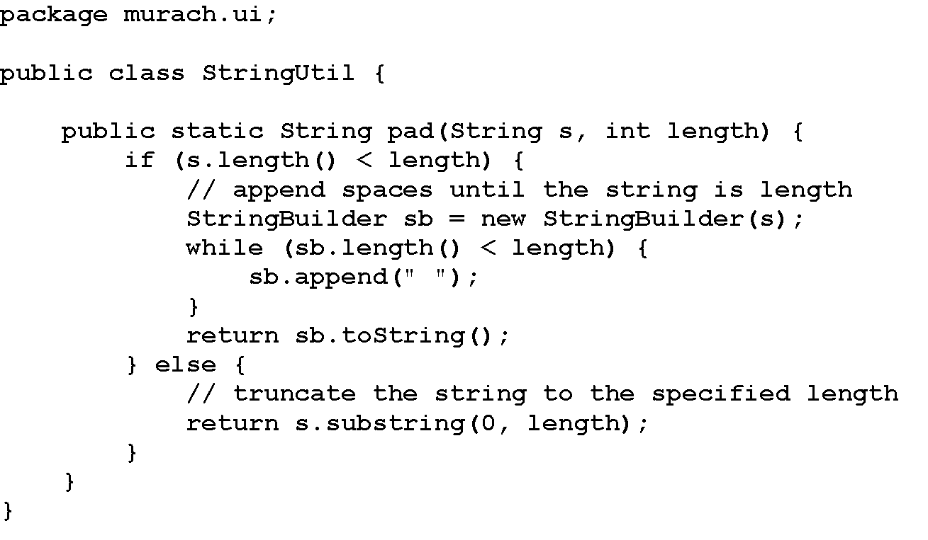
The StringUtil class

Slide 24
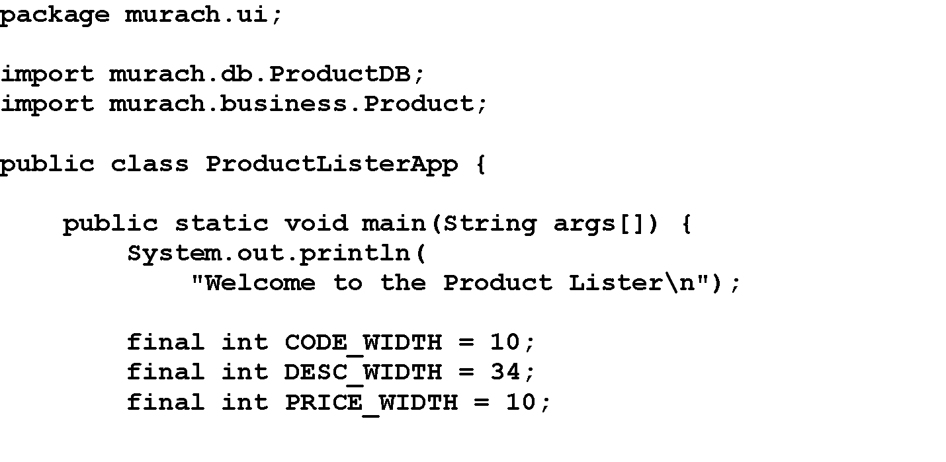
The ProductListerApp class

Slide 25
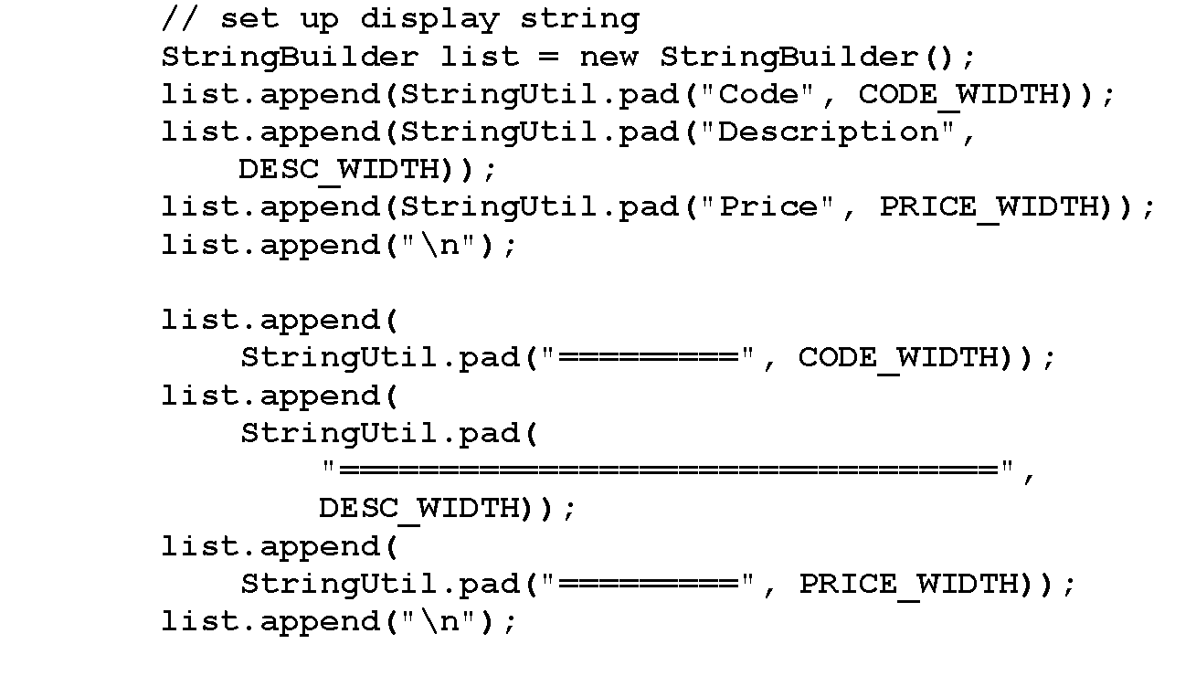
The ProductListerApp class (cont.)

Slide 26
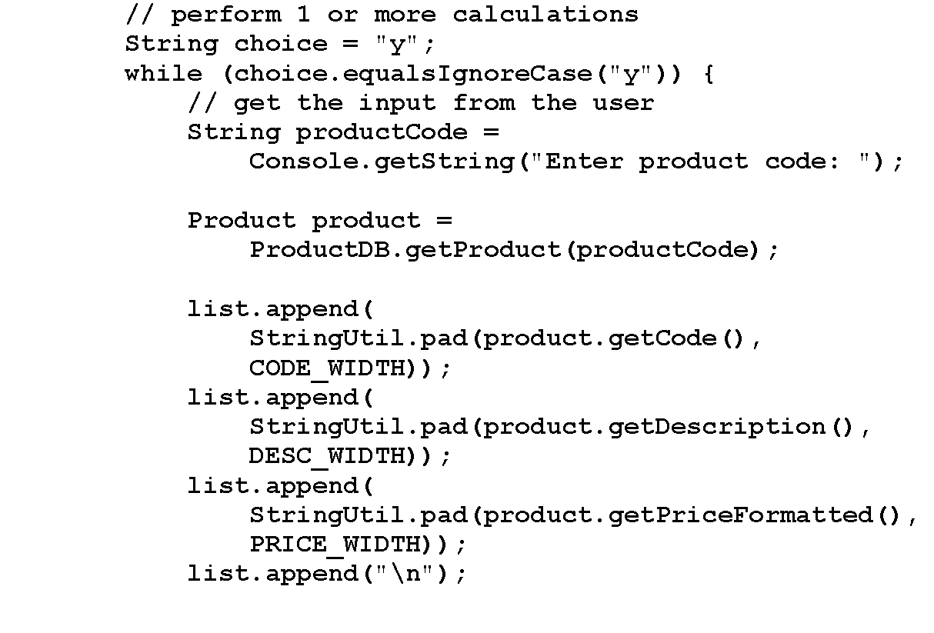
The ProductListerApp class (cont.)

Slide 27
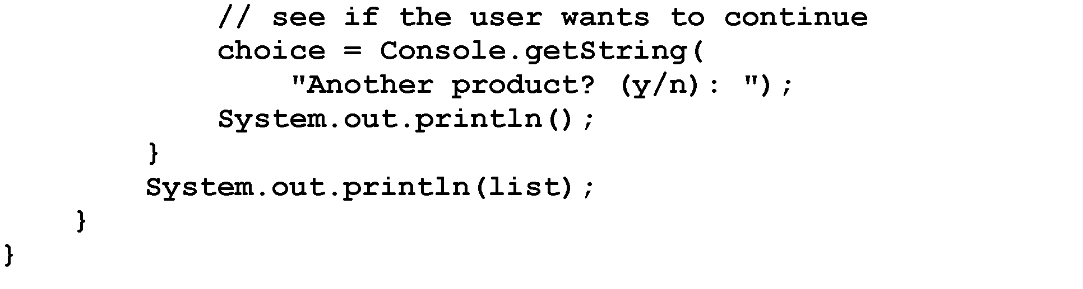
The ProductListerApp class (cont.)

